Slide 1







HTML, Forms, CSS & SCSS
Mohit Raj Purohit
Proudly recognized by

Slide 2
HTML and HTML Form Introduction
CSS Introduction
SCSS Introduction
Agenda

Slide 3
HTML Introduction

Slide 4
What is HTML?
HTML stands for HyperText Markup Language.
It is the standard language for creating web pages.
HTML structures the content of a webpage using elements and tags.
It tells the browser what content is (headings, paragraphs, links, images, etc.) and how to display it.
HTML is not a programming language; it is a markup language.
Example: <h1>Welcome to My Website</h1>
<p>This is a sample paragraph.</p>

Slide 5
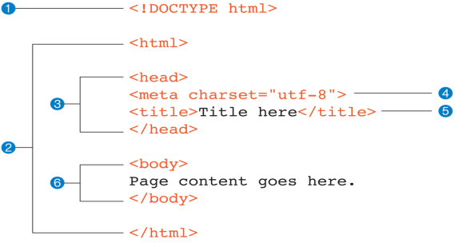
Document Structure

Slide 6
Meta tags (Tags under Head)
The <meta> tag provides metadata about the HTML document. Metadata will not be displayed on the page, but will be machine parsable.
Meta elements are typically used to specify page description, keywords, author of the document, last modified, and other metadata. Also, it helps to improve the SEO( Search Engine Optimization) of a web page by using certain keywords related to the web page.
<meta> tags always go inside the <head> element.
Following are few examples of <meta> tag with different attributes :
<title>Page Title</title> (Document Title)
<link> tag (Link external resources like css and favicon)
<meta name="keywords" content="HTML, CSS, XML, XHTML, JavaScript"> (For Search engines)
<meta name="description" content="Free Web tutorials on HTML and CSS"> ( Description of web page)
<meta name="author" content="John Doe"> (Author of web page)
<meta name="viewport" content="width=device-width, initial-scale=1.0"> (Responsiveness)
<script> (Add external and internal JS code)

Slide 7
Tags inside Body tag
Text & Headings
<h1> to <h6> → Headings (H1 = biggest, H6 = smallest)
<p> → Paragraph text
<strong>, <em> → To make text bold and italic
<br> → Line break
Links & Media
<a> → Hyperlink (e.g. <a href="https://example.com">Visit</a>)
<img> → Image (e.g. <img src="photo.jpg" alt="My photo">)
<video> → Video element
<audio> → Audio player
<iframe> → Embed external pages or YouTube videos
Lists
<ul> → Unordered list (bullets)
<ol> → Ordered list (numbers)
<li> → List item

Slide 8
Tags inside Body tag
Structure & Layout
<div> → Division or container (block-level)
<span> → Inline container (for styling small text parts)
<header>, <nav>, <main>, <section>, <article>, <footer> → Semantic layout tags (HTML5)
Forms & Inputs
<form> → Form container
<input> → Text boxes, checkboxes, etc.
<textarea> → Multi-line text box
<button> → Clickable button
<select> → Dropdown menu
<label> → Describes input fields
Interactive & Advanced
<script> → JavaScript code
<table> → Display tabular data (with <tr>, <td>, <th>)

Slide 9
Block-level and Inline-level Elements
HTML elements are of two main types:
Block-level elements
Always start on a new line.
Occupy the full available width (stretch across the container).
Common examples: <div>, <p>, <h1>–<h6>, <section>, <article>.
Inline-level elements
Do not start on a new line.
Take up only as much width as their content. Common examples: <span>, <a>, <img>, <strong>, <em>.

Slide 10
Form Elements
Forms are used to collect user input on a webpage.
<form> → defines a form container
<input type=”text”> → Used for single-line text such as names or usernames. Other types → text, password, email, number, checkbox, radio, date,
<button> → type → submit, button, reset
<textarea> → Used for multi-line text input (e.g., comments, feedback).
<select><option></option></select> → Allows users to choose from a list of options.
<label for="id">Label text</label> → Describes an input field, improving accessibility.
Example: https://gist.github.com/mohit-raj-purohit/acf959f50c67af5846fa701ec911d8e8

Slide 11
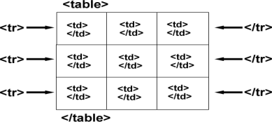
Tables
Tables are used to display data in rows and columns.
<table> → Defines a table container.
<thead> → Defines the header row of the table.
<tbody> → Contains all table data rows.
<tr> → Defines a table row
<td> → Defines a table data cell (regular cell).
<th> → Defines a table header cell (bold and centered by default).
Example: https://gist.github.com/mohit-raj-purohit/8d13a376102d120b084f8438c66cc041

Slide 12
HTML5 Semantic Tags
HTML5 is the latest version of HTML and it introduces many new tags and features. Semantic tags clearly describe the purpose and meaning of the content, making web pages more readable and SEO-friendly.
Some of the commonly used new tags of HTML5 are :
<article> → Defines an article in the document
<aside> → Defines content aside from the page content like sidebar.
<footer> → Defines a footer for the document or a section
<header> → Defines a header for the document or a section
<nav> → Defines navigation links in the document
<section> → Defines a section in the document

Slide 13
HTML5 Form Validations
HTML5 provides built-in form validation features, making it easier to check user input without JavaScript.
New input types and attributes were added to <input> tags that allow the browsers themselves to perform the browser/client-side validation.
HTML5 Attributes and types -
Required Field – Ensures a field is not left empty. Example: <input type="text" required>
Email Validation – Checks for proper email format. Example: <input type="email">
Number Validation – Ensures input is numeric and within range. Example: <input type="number" min="1" max="100">
URL Validation – Ensures a valid URL format. Example: <input type="url">
Password Validation – Can combine pattern and minlength for security. Example: <input type="password" minlength="8">
Pattern Matching – Validates input against a regular expression. Example: <input type="text" pattern="[A-Za-z]{3,}">
Example: https://gist.github.com/mohit-raj-purohit/d57f3b45236e9c6ce64d1a5e05c39db9

Slide 14
HTML5 APIs
HTML5 APIs make web applications more interactive and powerful. Key APIs:
Geolocation API → Access user’s location (with permission)
Local Storage / Session Storage → Store key-value data in the browser, supports string type only
Drag & Drop API → Enables dragging and dropping of HTML elements.
File API → Read and manipulate local files in the browser.
Other APIs:
Web Audio, Page Visibility, Vibration (For Mobile Devices), WebSocket, Canvas, History, Notification, Intersection Observer

Slide 15
Classes and Ids
IDs - You should only give elements an ID attribute if they are unique. They should be applied to that element only and nothing else. Classes -
Classes can be applied to multiple elements that share the same style properties. Things that should look and work in the same way can have the same class name.
Example: <ul id="categories">
<li class="item">Category 1</li>
<li class="item">Category 2</li>
<li class="item">Category 3</li>
</ul>

Slide 16
CSS Introduction

Slide 17
What is CSS?
CSS stands for Cascading Style Sheets
CSS is used to define styles for your web pages, including the design, layout and variations in display for different devices and screen sizes.
control layout of many documents from one single style sheet;

Slide 18
Types of CSS
Inline CSS - Styles are written directly inside an HTML element using the style attribute and it affects only that specific element.
Example - <p style="color: blue;">This is inline CSS</p>
Internal CSS - Styles are defined within the <style> tag inside the <head> section of an HTML page. It affects only that single webpage.
Example - <style>
p { color: green; }
</style>
External CSS - Styles are written in a separate .css file and linked using the <link> tag. It allows consistent styling across multiple pages. Example - <link rel="stylesheet" href="style.css">

Slide 19
CSS Selectors
CSS selectors are used to target HTML elements and apply specific styles to them.
Universal Selector (*) - Selects all elements on a page. Example - * { margin: 0; padding: 0; }
Element Selector - Targets an HTML tag directly.. Example - p { color: green; }
Class Selector (.) - Targets elements with a specific class name. Example - .title { font-size: 20px; }
ID Selector (#) - Targets elements with a specific ID. Example - #header { background: lightgray; }
Group Selector (,) - Applies the same style to multiple elements.. Example - h1, h2, h3 { color: navy; }
Descendant Selector (space) - Targets elements inside another element. Example - div p { color: green; }
Attribute Selector ([]) - Targets elements based on attributes. Example - input[type="text"] { border: 1px solid black; }

Slide 20
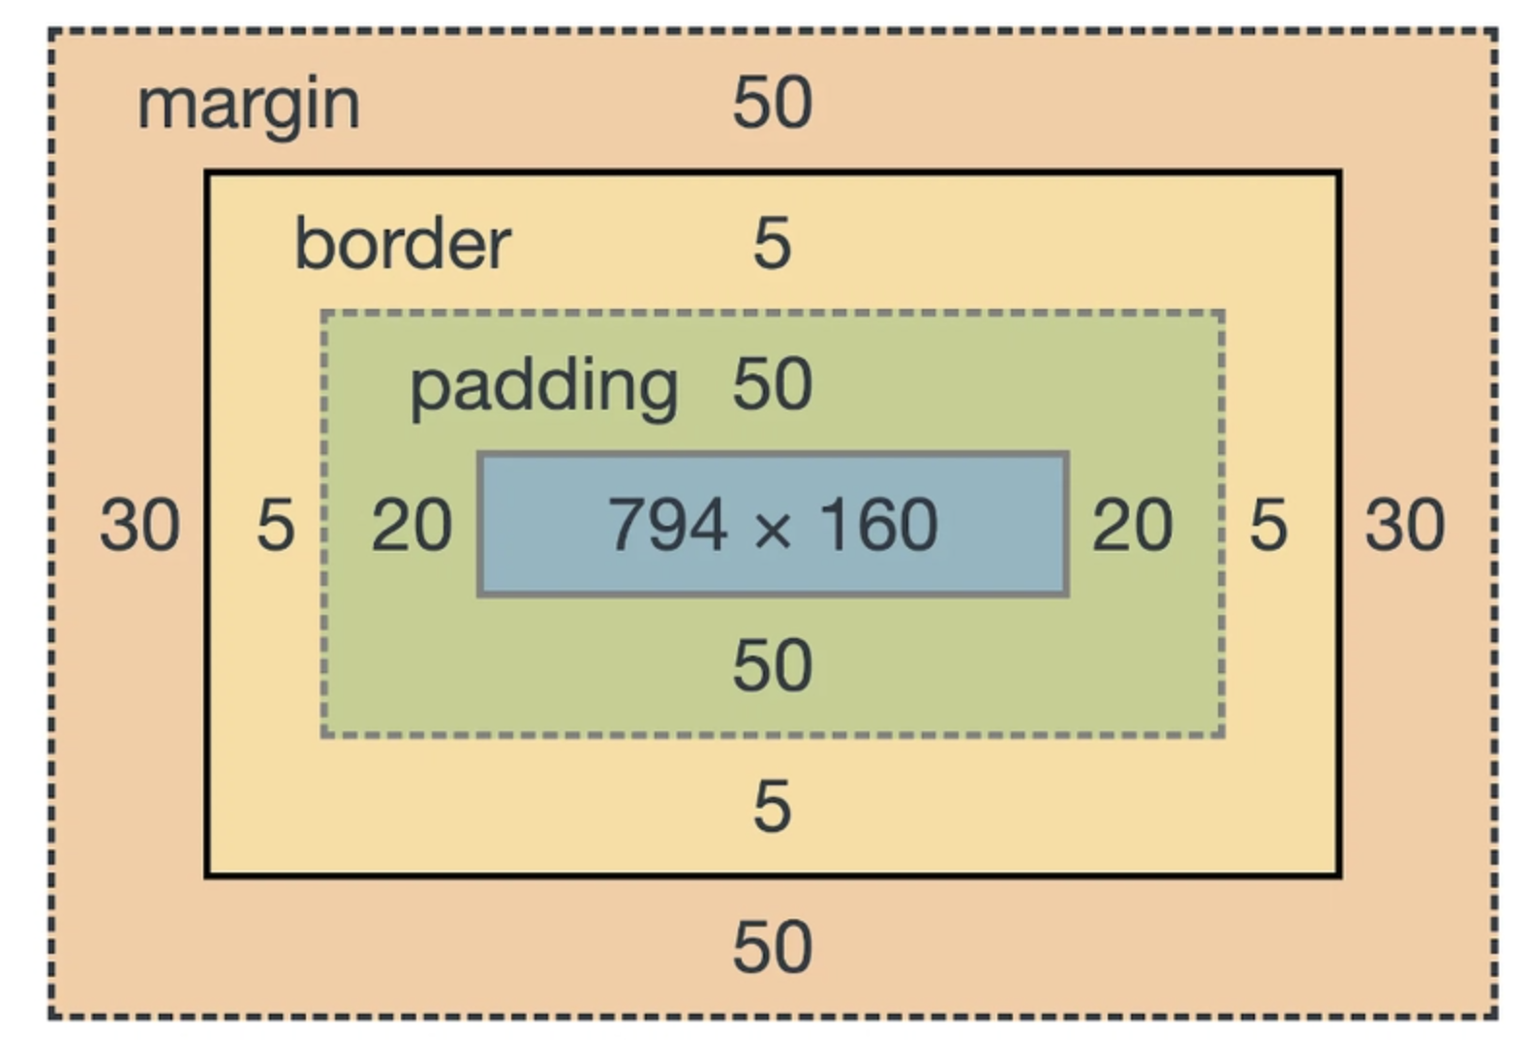
CSS Box Model
The CSS Box Model describes how HTML elements are structured and spaced on a webpage.
Every element is treated as a rectangular box consisting of four layers.
Box Model Components:
Content – The actual text, image, or element content.
Padding – Space inside the box, between content and border.
Border – The edge surrounding padding and content.
Margin – Space outside the box, separating it from other elements.

Slide 21
CSS Units
CSS units define the measurement values (like size, spacing, or positioning) used to style elements on a webpage.
Absolute Units: Fixed size; don’t change with screen or font.
px – Pixels (most commonly used)
in – Inches
cm, mm – Centimeters, Millimeters
Relative Units: Size depends on other elements or viewport.
em – Relative to the parent font size
rem – Relative to the root (html) font size
% – Relative to the parent element’s size
vw / vh – Relative to viewport width/height

Slide 22
Some Commonly Used CSS properties
padding -
padding-top:10px;
padding-right:10px;
padding-bottom:10px;
padding-left:10px;
Or
padding:10px;
margin
margin-top:10px;
margin-right:10px;
margin-bottom:10px;
margin-left:10px;
Or
margin:10px;
border
border: 1px solid black;

Slide 23
Some Commonly Used CSS properties
display - display is CSS's most important property for controlling layout. Every element has a default display value depending on what type of element it is.
display: block;
display: inline;
display: inline-block;
display: none;
color - The color property in CSS is used to set the text color of HTML elements.
p {
color: blue;
}
border-radius - To make the Box corner rounded
border-radius: 6px;

Slide 24
Some Commonly Used CSS properties
background - Used to set the background color, image, or other background properties in one line
body {
background: lightblue;
}
div {
background: #ffcc00 url("pattern.png") no-repeat right top;
}
background-image - Specifically used to set an image as the background of an element, The image repeats by default unless controlled with background-repeat.
body {
background-image: url("bg.jpg");
background-repeat: no-repeat;
background-size: cover;
}

Slide 25
Some Commonly Used CSS properties
text-align - The text-align CSS property describes how inline content like text is aligned in its parent block element. text-align does not control the alignment of block elements, only their inline content.
text-align: value;
text-align: left;
text-align: right;
text-align: center;
text-align: justify;
float - Used to position an element to the left or right side of its container.
selector {
float: left | right | none | inherit;
}
clear - Used to control the behavior of floating elements.
selector {
clear: left | right | both | none;
}

Slide 26
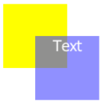
Some Commonly Used CSS properties
Position - Defines how an element is placed on a webpage.
static - Default value; element positioned normally in the page flow.
relative - Positioned relative to its normal position.
fixed - Default value; element positioned normally in the page flow.
absolute - Positioned relative to the browser window or the positioned element, stays in same place when scrolling.
sticky - Combines features of relative and fixed positions.
top - Moves the element down from the top edge of its positioned ancestor.
bottom - Moves the element up from the bottom edge of its positioned ancestor.
left - Moves the element right from the left edge of its positioned ancestor.
right - Moves the element left from the right edge of its positioned ancestor.
z-index - Controls the stacking order of elements (which one appears on top). Works only on positioned elements

Slide 27
Pseudo Classes
Pseudo-classes → Define a special state of an element.
:focus - style an input field when it gets focus:
:link - styles unvisited links
:visited - styles visited links
:hover - styles an link on mouse over
:active - styles an activated link
:first-child - pseudo-class matches a specific element that is the first child of another element
:last-child - pseudo-class matches a specific element that is the last child of another element
Example
a:hover {
color: #FF00FF; /* Magenta */
}
a:hover {
color: #0000FF; /* Blue */
}

Slide 28
Pseudo Elements
Pseudo-Elements → Style a specific part of an element.
Common use -
Style the first letter or first line, of an element
Insert content before or after an element
Style the markers of list items
Style the user-selected portion of an element
Style the viewbox behind a dialog box
::after - is used to insert some content after the content of a specified element
::before - is used to insert some content before the content of a specified element. Example - h3::after {
content: ‘I am in after’;
}

Slide 29
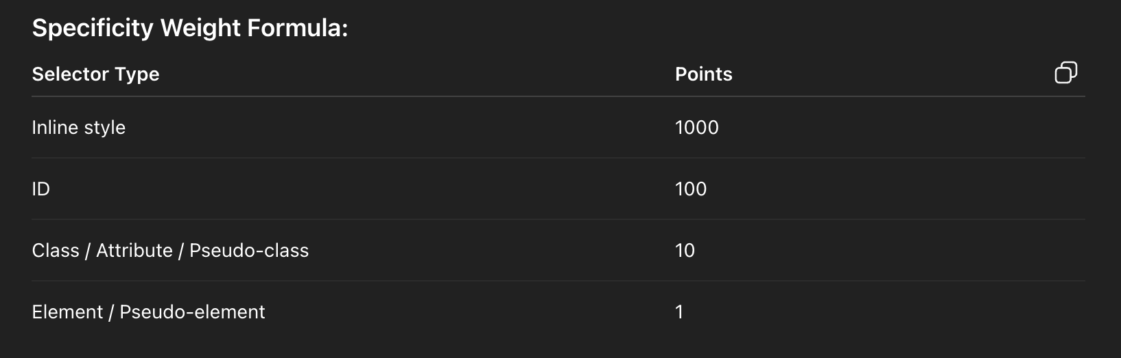
CSS Specificity
CSS specificity determines which CSS rule applies when multiple rules target the same element.
It’s like a ranking system for styles.
Inline styles → Highest priority
ID selectors → Higher priority than class or element selectors
Class, attribute, pseudo-class selectors → Medium priority
Element and pseudo-element selectors → Lowest priority
Example p { color: black; } /* 1 point */
.menu p { color: green; } /* 11 points */ -> 10 + 1
#header p { color: blue; } /* 101 points */ -> 100 + 1
#header #container p {color: red} /* 100 + 100 + 1 -> 201 */

Slide 30
CSS3
Flexbox -
Flexbox (Flexible Box) is a CSS layout module that makes it easier to design flexible and responsive layouts without using floats or positioning.
Flex Container – The parent element that defines a flex context using .container {
display: flex;
}
Flex Items – The direct children of a flex container.
CSS Properties -
flex-direction - Sets the main axis (row, row-reverse, column, column-reverse).
justify-content - Align items along the main axis (flex-start, center, space-between, space-around).
align-items - Align items along the cross axis (flex-start, center, stretch).
flex-wrap - Controls wrapping of items (nowrap, wrap, wrap-reverse).

Slide 31
Media Queries
When we have to make a web page responsive, we need to specify that which CSS properties will be applied on a particular viewport (device screen). This can be achieved by using media queries in our CSS file.
Let’s understand this better with an example
@media screen/print and (min-width: 480px) { body { background-color: lightgreen; } }
So, the above code will work only when the device width is at least 480px. Hence, this code will not work on devices who’s width will be less than 480px.

Slide 32
SCSS Introduction

Slide 33
What is SASS/SCSS?
SASS (Syntactically Awesome Style Sheets) is a CSS preprocessor that extends CSS with variables, nesting, mixins, and more, making stylesheets easier to write and maintain.
SCSS is the most commonly used syntax of SASS, fully CSS-compatible and uses {} and ; like regular CSS.
VS code, Live Server, Node
Installation step -
Using Node Package Manager (NPM)
npm install -g sass
Usage
sass source/stylesheets/index.scss build/stylesheets/index.css
In watch mode sass --watch input.scss output.css

Slide 34
What is SASS/SCSS?
Key Benefits -
Variables: Store reusable values like colors, fonts, etc.
Nesting: Organize CSS hierarchically, like HTML.
Mixins: Reusable blocks of styles with arguments.
Partials: Modularize stylesheets for maintainability.
Inheritance: Share styles across selectors with @extend.
Math & Functions: Perform calculations and use built-in functions.

Slide 35
Variables
SCSS variables allow you to store reusable values such as colors, fonts, sizes, or any CSS value.
They make your stylesheet cleaner and easier to maintain.
Example -
$primary-color: #3498db;
$font-stack: 'Arial, sans-serif';
$padding-size: 10px;
body {
color: $primary-color;
font-family: $font-stack;
padding: $padding-size;
}
button {
background-color: $primary-color;
padding: $padding-size;
}

Slide 36
Nesting
Nesting in SCSS allows you to write CSS selectors inside other selectors, reflecting the HTML
Example -
nav {
background-color: #333;
ul {
list-style: none;
li {
display: inline-block;
margin-right: 20px;
&:hover {
color: #ffcc00;
}
}
}
}

Slide 37
Mixins
A mixin is a reusable block of CSS code in SCSS that you can include in multiple selectors, helping avoid repetition.
Example -
@mixin flex-center {
display: flex;
justify-content: center;
align-items: center;
}
.container {
@include flex-center;
height: 200px;
background-color: lightblue;
}
.button {
@include flex-center;
padding: 10px 20px;
background-color: #3498db;
color: white;
}

Slide 38
Partials & Imports
Partials are SCSS files that contain small pieces of CSS (like variables, mixins, or components) and start with an underscore _.
Imports are used to combine multiple SCSS files into one main stylesheet using @import (or @use in modern SCSS).
Example -
File - partials/_variables.scss
$primary-color: #3498db;
$padding-size: 10px;
File - main.scss
@import 'partials/variables';
.container {
padding: $padding-size;
background-color: $primary-color;
}

Slide 39
Exercise
https://www.figma.com/design/IlXGysxi6wrxEhvAJ5G660/Minimal-Landing-Page-Design-%7C-Website-Home-Page-Design-%7C-Agency-Website-UI-Design--Community-?node-id=5-573&t=AluilxEX2mu8fwi7-0

Slide 40
Feedback
https://forms.gle/ne3AfP1s7a2WpGjW9

Slide 41
Thank You

